Slide 1

Artificial Intelligence for Business Decisions and Transformation
CSCN8030 - Spring 2024 - Section 2
Sprint 5 - Demo
July 22, 2024
Group 4 - Members:
Krishna Kumar, Hemasree
Shijin, Jency
Fernandez, Arcadio
Professor:
Glaucia Melo dos Santos, PhD

Slide 2

Our focus
User Interest Profiling for TikTok Reviews
Project Idea: Develop a system to automatically identify and classify user interest profiles based on user reviews.
Techniques: Supervised learning, sentiment analysis
Outcome: This will help in understanding user preferences, improving content recommendations, and aiding influencers in tailoring their content strategies

Slide 3
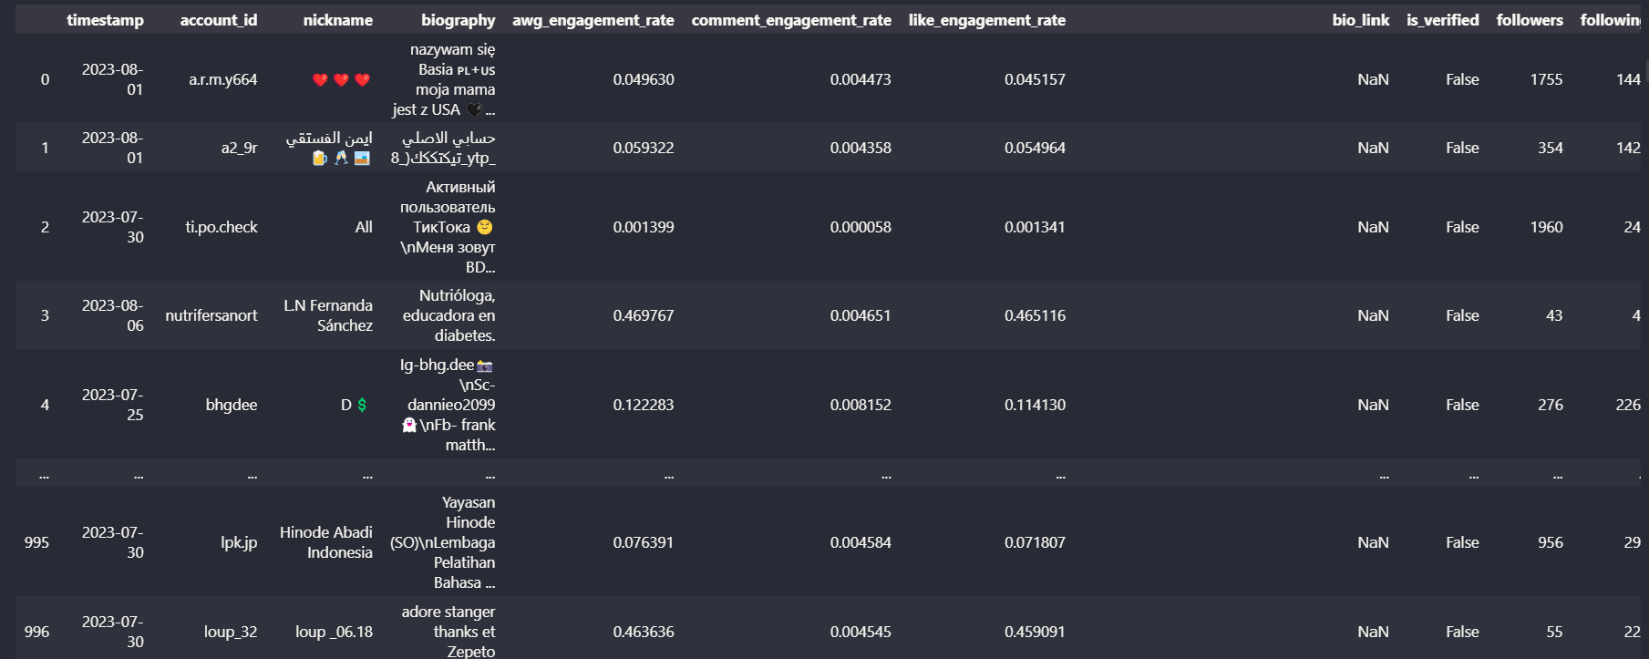
Data

Slide 4
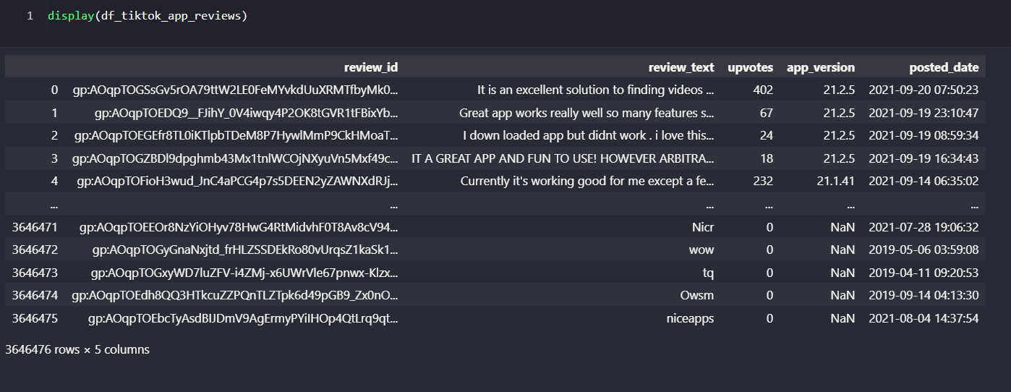
Data

Slide 5
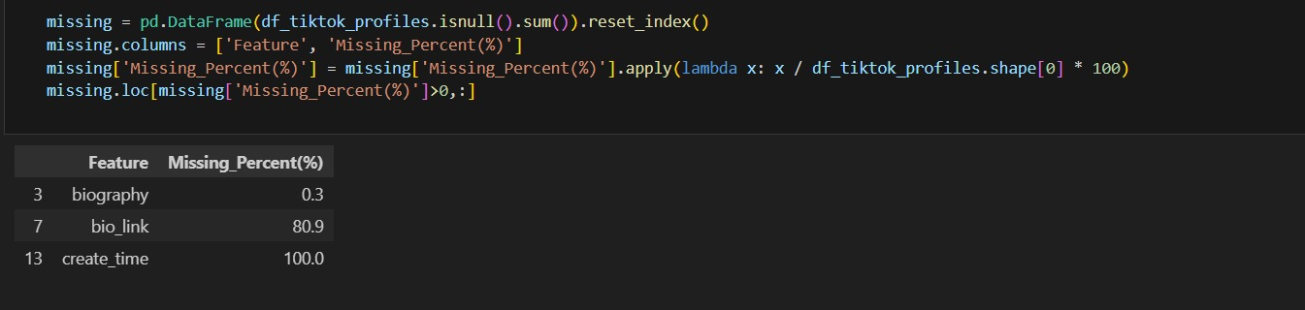
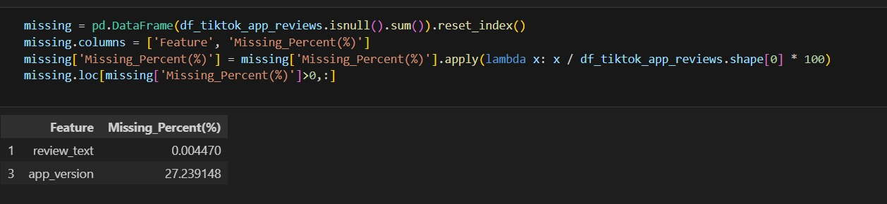
2. Clean the data by handling missing values, correcting data types, and ensuring data consistency.
There are around 3 Million user reviews

Slide 6
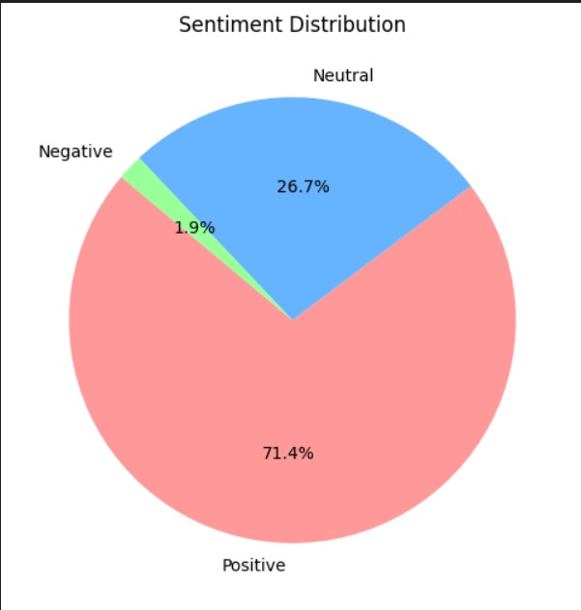
3. Exploratory Data Analysis
The pie chart showing the distribution of sentiments derived from TikTok app reviews.
Positive Sentiment (71.4%): The majority of the reviews are positive, indicating that most users have a favorable opinion of the TikTok app.
Neutral Sentiment (26.7%): A significant portion of the reviews are neutral, suggesting that these users have a balanced or indifferent view of the app.
Negative Sentiment (1.9%): A small fraction of the reviews are negative, indicating that a minority of users have issues or negative opinions about the app.

Slide 7
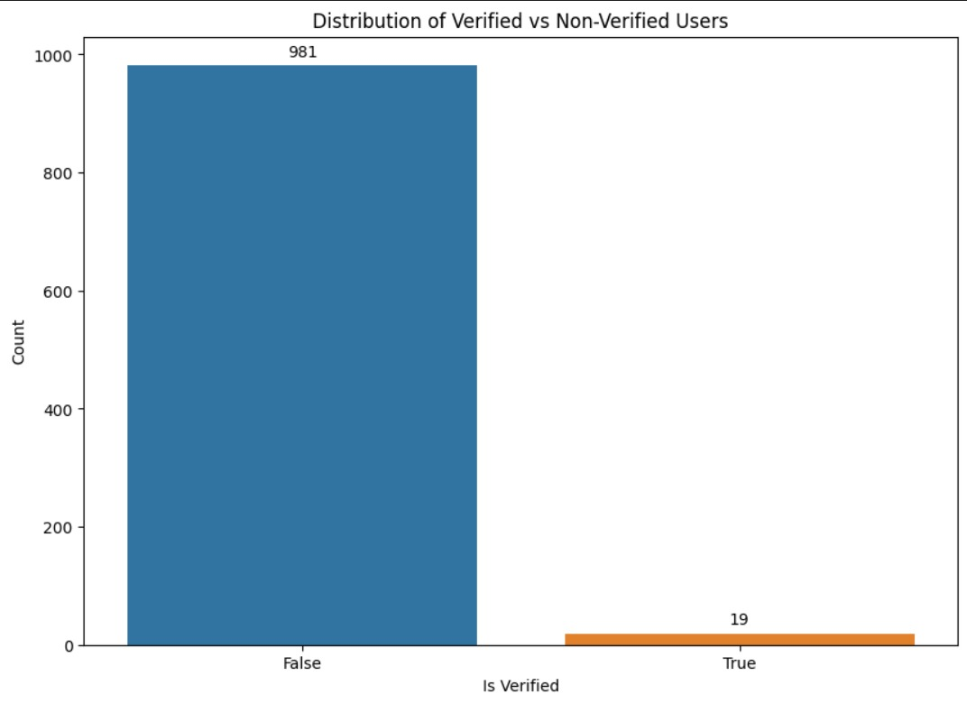
3. Exploratory Data Analysis
The bar chart displaying the distribution of verified and non-verified TikTok users.
Non-Verified Users: The bar on the left (blue) shows the number of non-verified users, which is significantly higher, with a count of 981.
Verified Users: The bar on the right (orange) shows the number of verified users, which is much lower, with a count of 19.

Slide 8
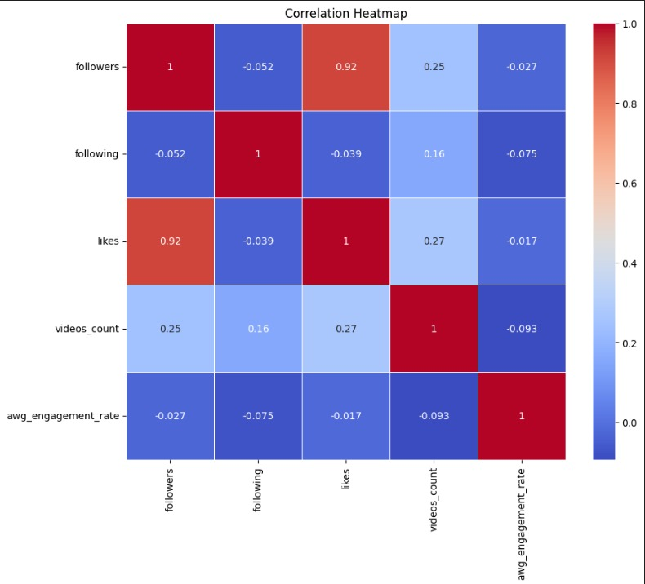
3. Exploratory Data Analysis
The correlation heatmap shows the relationships between different numerical variables in the TikTok profiles dataset
Followers and Likes (0.92): There is a very strong positive correlation between the number of followers and the number of likes. Users with more followers tend to receive more likes.
Videos Count and Likes (0.27): There is a moderate positive correlation between the number of videos uploaded and the number of likes. Users who upload more videos tend to receive more likes.
Followers and Videos Count (0.25): There is a moderate positive correlation between the number of followers and the number of videos uploaded.
Following and Followers (-0.052): There is a very weak negative correlation between the number of accounts a user is following and their number of followers.

Slide 9
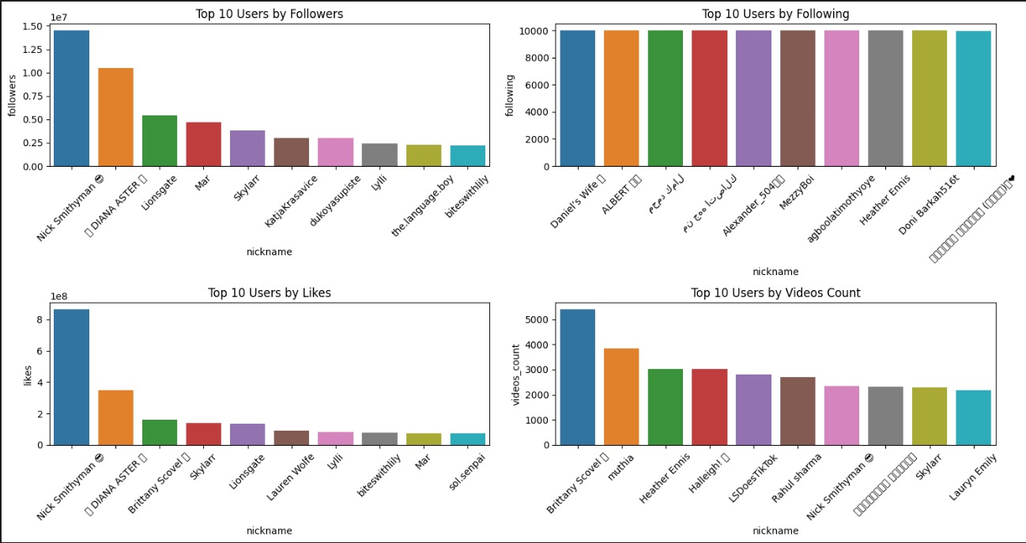
3. Exploratory Data Analysis

Slide 10
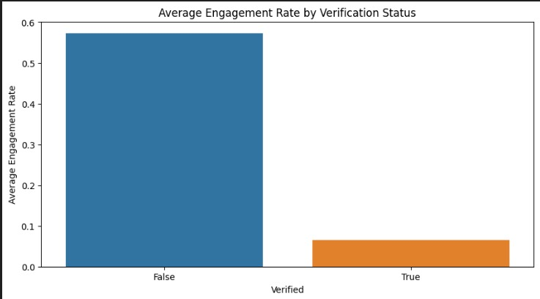
The bar chart showing the average engagement rate for verified and non-verified TikTok users.
Non-Verified Users( false): shows the average engagement rate for non-verified users, which is significantly higher, around 0.55.
Verified Users (true) :shows the average engagement rate for verified users, which is much lower, around 0.1.

Slide 11
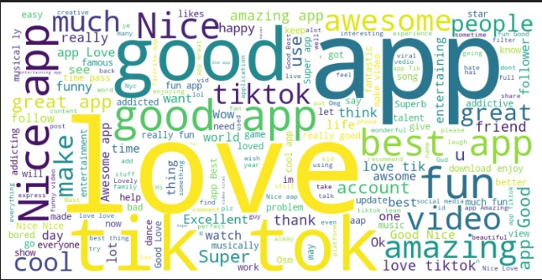
3. Exploratory Data Analysis
The provided figure is a word cloud generated from the textual content of TikTok app reviews.
The word cloud visualizes the most frequently occurring words in the TikTok app reviews dataset.
Larger words in the word cloud represent words that appear more frequently in the reviews, while smaller words are less frequent.
Words like "app," "good," "love," "TikTok," "nice," "fun," and "amazing" appear prominently in the word cloud.
These words suggest that users generally have positive sentiments towards the app, as indicated by words like "good," "love," "fun," "amazing," and "nice.

Slide 12
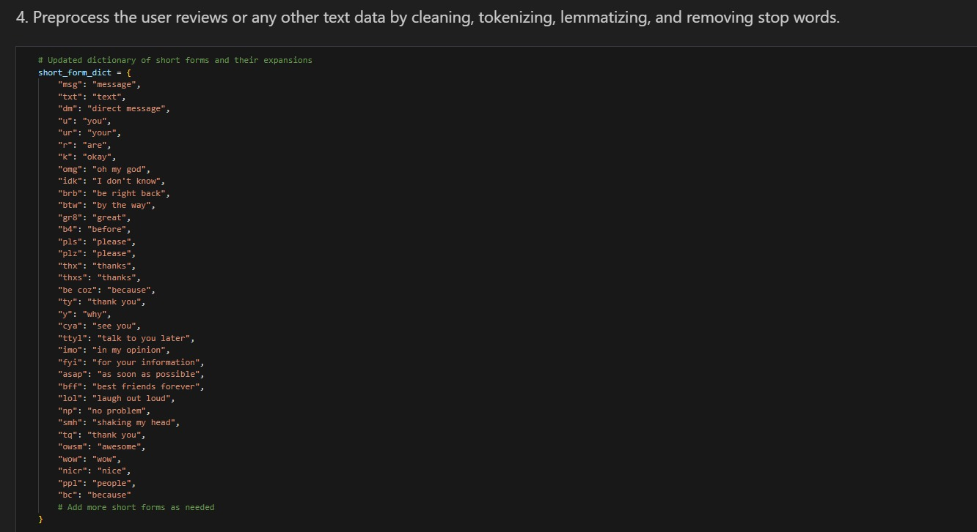
4. Preprocess the user reviews or any other text data by cleaning, tokenizing, lemmatizing, and removing stop words.

Slide 13
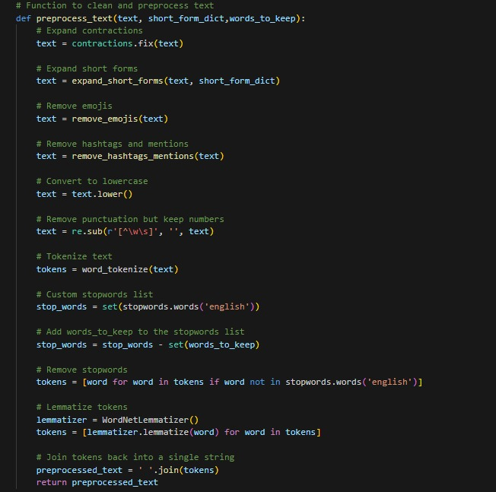
4. Preprocess the user reviews or any other text data by cleaning, tokenizing, lemmatizing, and removing stop words.

Slide 14
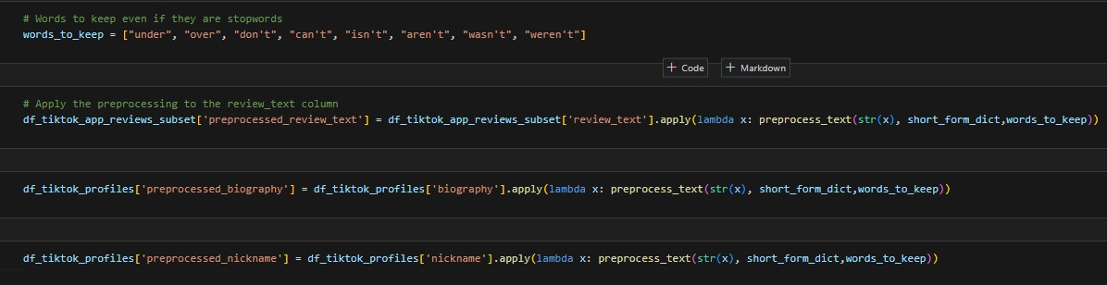
4. Preprocess the user reviews or any other text data by cleaning, tokenizing, lemmatizing, and removing stop words.

Slide 15
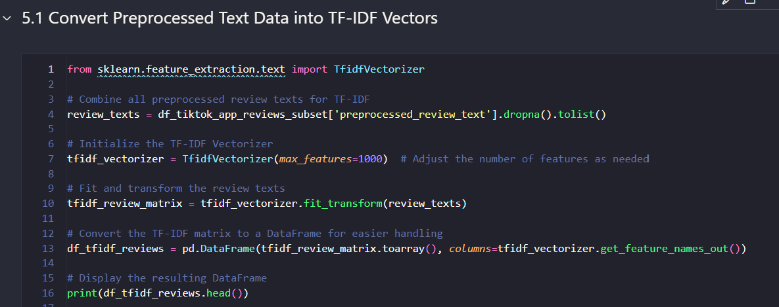
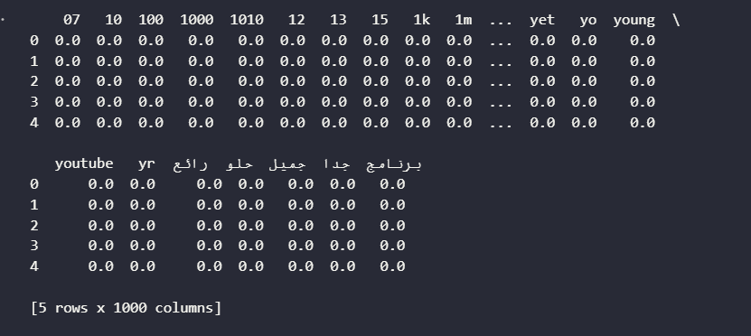
5. Convert the preprocessed text data into numerical representations using text embeddings such as BERT, FastText, or TF-IDF.
- TF-IDF is the fastest and most efficient for large datasets when you do not need deep contextual information.
- FastText offers a balance between speed and context but is slower than TF-IDF.
- BERT provides the most detailed and context-aware embeddings but is the slowest due to its computational complexity.

Slide 16
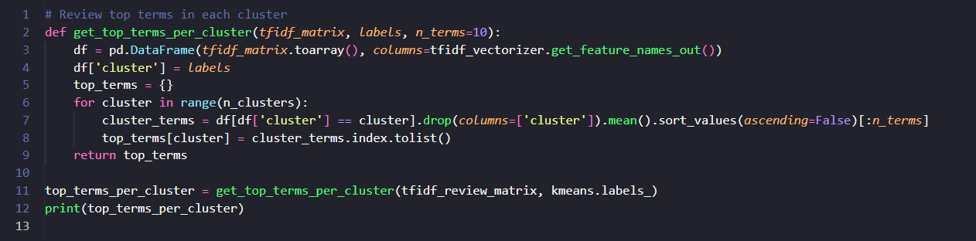
6.Perform Clustering to Group Reviews
6.1. Perform Clustering to Group Reviews
{0: ['nice', 'app', 'best', 'amazing', 'fun', 'awesome', 'great', 'super', 'cool', 'love’],
1: ['aap', 'nice', 'good', 'best', 'love', 'amazing', 'tok', 'tik', 'like', 'super’],
2: ['good', 'app', 'really', 'apps', 'nice', 'fun', 'tiktok', 'love', 'video', 'funny’],
3: ['like', 'app', 'tiktok', 'much', 'video', 'tik', 'tok', 'really', 'good', 'please’],
4: ['love', 'app', 'tiktok', 'much', 'tik', 'tok', 'fun', 'amazing', 'musically', 'best']}

Slide 17
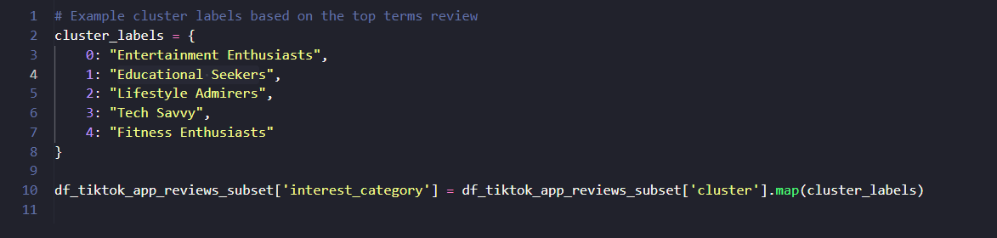
6.Perform Clustering to Group Reviews
6.2. Review and Label Clusters

Slide 18
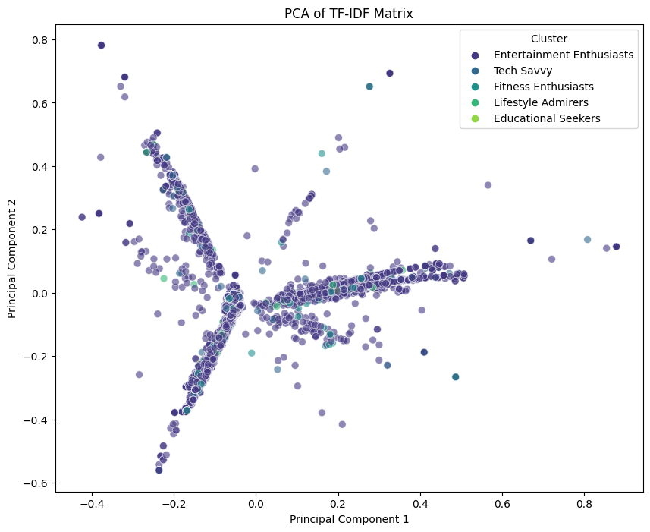
6.Perform Clustering to Group Reviews
6.3. Plot the clusters
The provided graph visualizes the Principal Component Analysis (PCA) of the TF-IDF matrix applied to TikTok app reviews. Here’s a detailed explanation of the graph:
Principal Component Analysis (PCA):
PCA is a dimensionality reduction technique used to reduce the number of features while preserving the variance in the data.
In this case, the high-dimensional TF-IDF matrix (text data transformed into numerical form) has been reduced to two principal components (PC1 and PC2) for visualization purposes.
Clusters:
The data points are color-coded based on the clusters identified through K-Means clustering.
Each color represents a different cluster,
The distinct clusters indicate that the reviews can be grouped into different interest categories based on their textual content

Slide 19
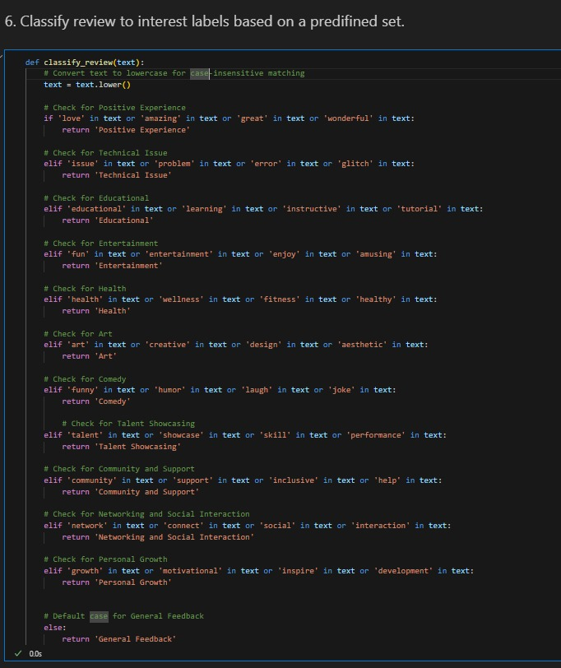
6.4. Manual labeling of User reviews

Slide 20
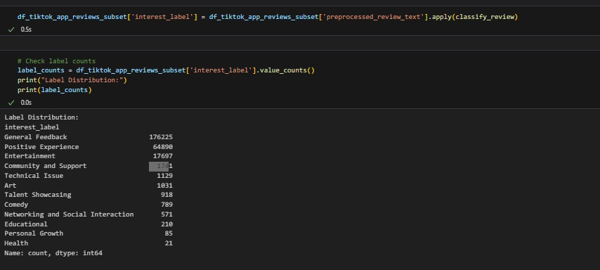
6. Manual labeling of User reviews

Slide 21
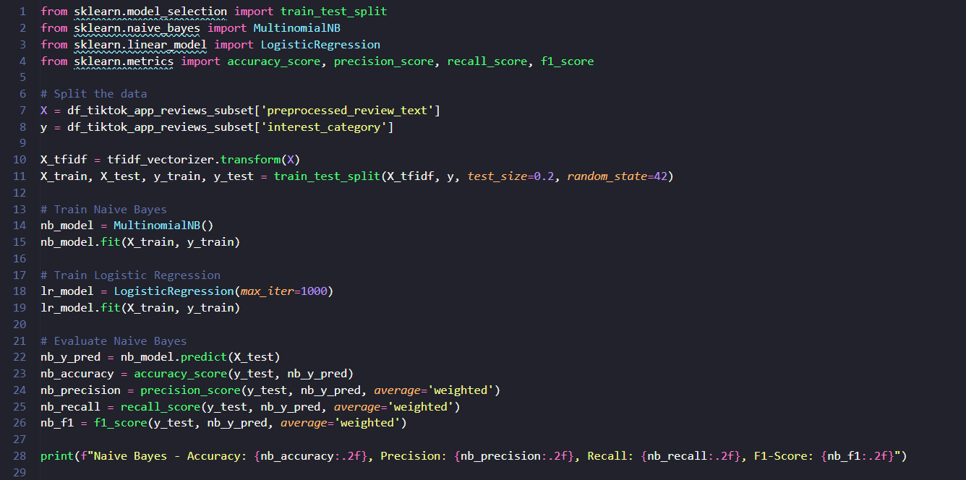
7. Train a Supervised Model
Now that you have labeled data, you can train a supervised model (Naive Bayes) to predict these labels.

Slide 22
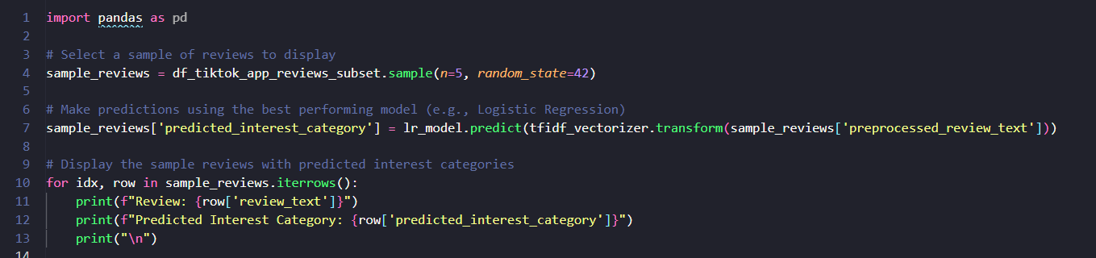
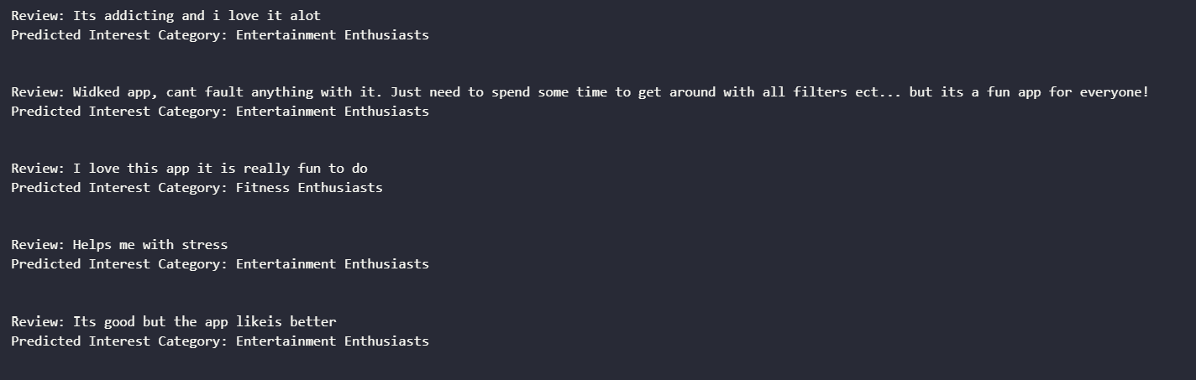
7. Train a Supervised Model
Make Predictions on a Subset of Reviews
Next, let's make predictions on a subset of the data and display some reviews with their predicted categories:

Slide 23
8. Next Steps
Currently we used Clustering and manual method for arriving at labels/user interest categories which doesn’t seem to provide meaningful results.
As a next step we are going to use pre-trained model such zero-shot-classification for annotating the dataset into user interest profiles and use it for training the model.
We used TF-IDF vectorizer for feature extraction because it was fast and efficient for large datasets but it doesn’t provide deep contextual information. So, we will use BERT embeddings in the future

Slide 24
9. Insights to improve business based on the demo algorithm
Personalized Content Recommendations:
By categorizing users into specific interest groups TikTok can tailor content recommendations to better match user preferences. This personalized approach can enhance user satisfaction and engagement.
Targeted Marketing Campaigns:
The interest categories derived from user reviews can inform more effective marketing strategies. Advertisers can target specific groups with tailored ads that resonate with their interests, increasing the likelihood of conversion.
Feature Development and Optimization:
By analyzing the top terms and sentiments associated with different interest groups, TikTok can identify trending topics and emerging user needs. This can guide the development of new features or the enhancement of existing ones.

